Slide 1
Definition of a Distributed System (1)
A distributed system is:
A collection of independent computers that appears to its users as a single coherent system.

Slide 2
Definitions of a Distributed System:
One important characters of DS is that differences between the various computers and the way in which they communicate are hidden from users. (Transparency)
Users and applications can interact with a distributed system in a consistent and uniform way, regardless of where and when interaction take place.(Coherency)
D.S should also be easy to expand or scale. (Scalability)
A DS will normally be continuously available, although perhaps certain parts may be temporarily out of order. (Reliability)

Slide 3
Transparency
A important goal of a distributed system is to hide the fact that its process and resource are physically distributed across multiple computers
A DS that is able to present itself to users and applications as if it were only a single computer system is said to be transparent

Slide 4
Transparency in a Distributed System
Transparency | Description
Access | Hide differences in data representation and how a resource is accessed
Location | Hide where a resource is located
Migration | Hide that a resource may move to another location Without affecting how that resources can be accessed
Relocation | Hide that a resource may be moved to another location while in use
Replication | Hide that a resource may be shared by several competitive users
Concurrency | Hide that a resource may be shared by several competitive users
Failure | Hide the failure and recovery of a resource
Persistence | Hide whether a (software) resource is in memory or on disk
Different forms of transparency in a distributed system.

Slide 5
Scalability
Scalability of a system can be measured along at least three dimensions
Size: add more users and resources to the system
geographically scalable : system is one in which the users and resources may lie far apart
Administratively scalable: easy to manage even if it spans many independent administrative organization

Slide 6
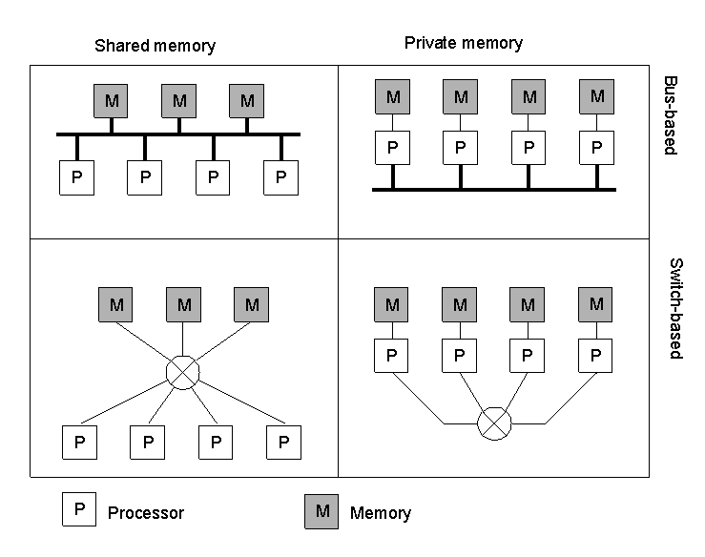
Hardware Concepts
1.6
Different basic organizations and memories in distributed computer systems

Slide 7
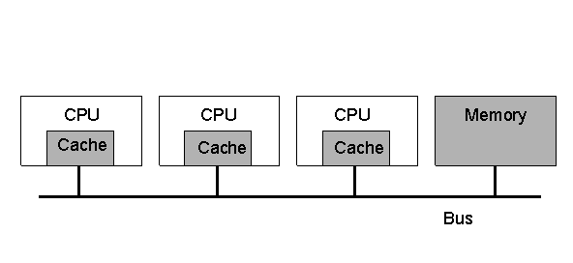
Multiprocessors (1)
1.7
A bus-based multiprocessor.

Slide 8
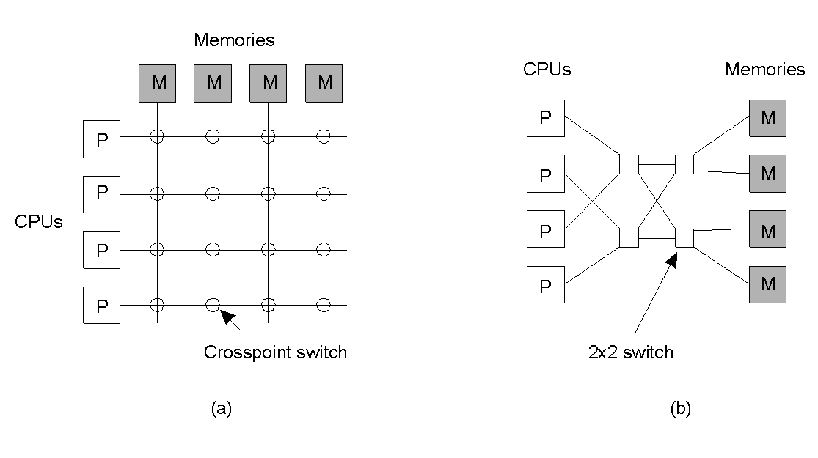
Multiprocessors (2)
1.8
A crossbar switch
An omega switching network

Slide 9

Distributed System Types
(Functionally)
1. Distributed computing system.
2. Distributed information system
      Transaction processing system (TPS) and
      Enterprise Application Integration (EAI)
3. Distributed pervasive system.

Slide 10
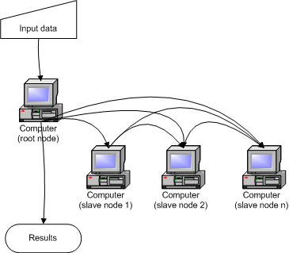
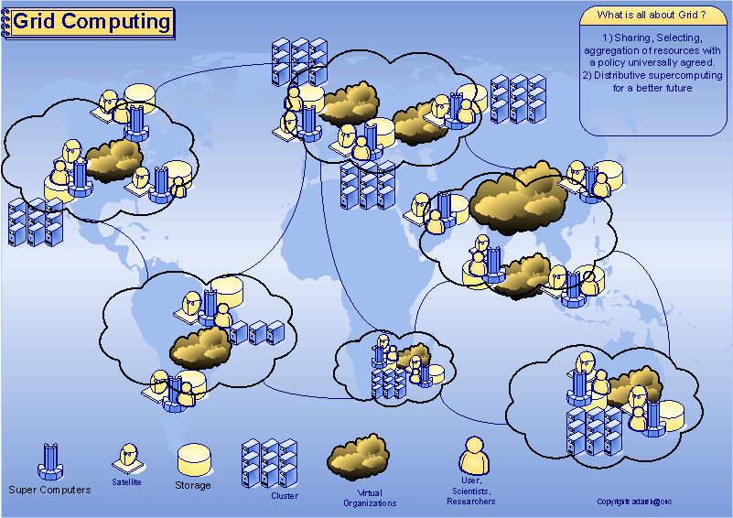
Cluster Computing
Grid Computing

Slide 11
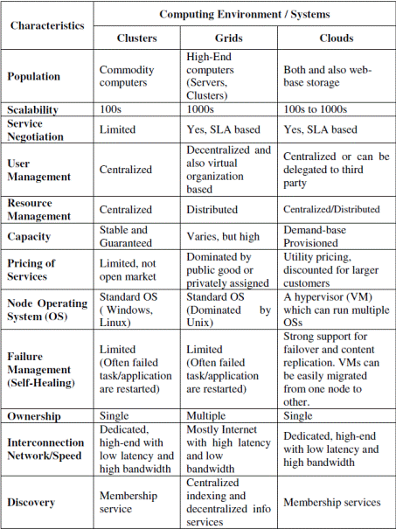

Slide 12
Distributed Computing Models
1. Architectural model : Client-server model and the peer-to-peer (P2P)
2. Interaction model : synchronous distributed systems and asynchronous distributed systems
3. Fault model: Omission fault, Arbitrary fault and timing fault
4. Security model: use combination of authentication and encryption methods

Slide 13
Distributed Computing System Models
Interconnections
Mini Computer Model
Workstation Model
Workstation-Server Model
Processor-Pool Model
Hybrid Model

Slide 14
Software Concepts
System | Description | Main Goal
DOS | Tightly-coupled operating system for multi-processors and homogeneous multicomputers | Hide and manage hardware resources
NOS | Loosely-coupled operating system for heterogeneous multicomputers (LAN and WAN) | Offer local services to remote clients
Middleware | Additional layer atop of NOS implementing general-purpose services | Provide distribution transparency
An overview between
DOS (Distributed Operating Systems)
NOS (Network Operating Systems)
Middleware

Slide 15
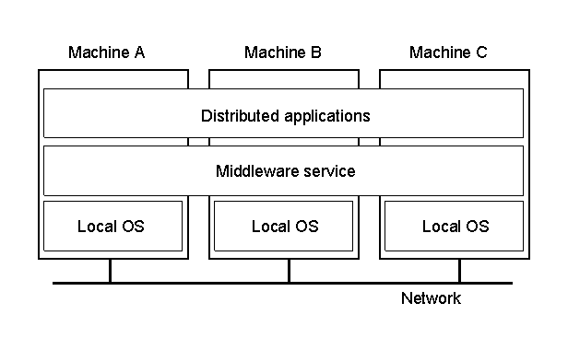
Definition of a Distributed System (2)
1.1
A distributed system organized as middleware.
Note that the middleware layer extends over multiple machines.

Slide 16
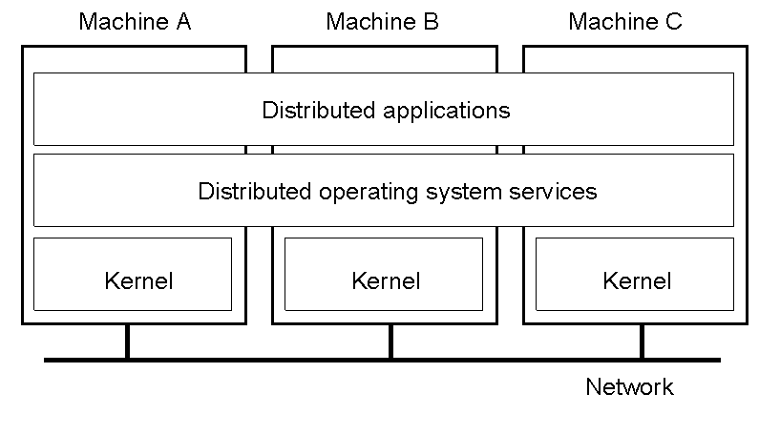
Multicomputer Operating Systems (1)
1.14
General structure of a multicomputer operating system

Slide 17
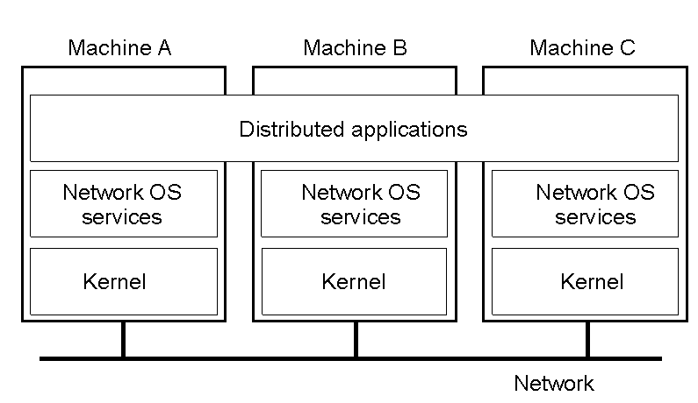
Network Operating System (1)
1-19
General structure of a network operating system.

Slide 18

Positioning Middleware
1-22
General structure of a distributed system as middleware.

Slide 19

Middleware
1.23
In an open middleware-based distributed system, the protocols used by each middleware layer should be the same, as well as the interfaces they offer to applications.

Slide 20
Comparison between Systems
Item | Distributed OS |  | Network OS | Middleware-based OS
 | Multiproc. | Multicomp.
Degree of transparency | Very High | High | Low | High
Same OS on all nodes | Yes | Yes | No | No
Number of copies of OS | 1 | N | N | N
Basis for communication | Shared memory | Messages | Files | Model specific
Resource management | Global, central | Global, distributed | Per node | Per node
Scalability | No | Moderately | Yes | Varies
Openness | Closed | Closed | Open | Open
A comparison between multiprocessor operating systems, multicomputer operating systems, network operating systems, and middleware based distributed systems.

Slide 21
Network Operating system :(supports 2 tier architecture)
Only follow RPC,RMI No application server involved
1)Windows NT (2000,XP)
2)Ubuntu
3)Linux
4) Windows 2003, Windows 2000 Advanced Server , Windows Server 2003
Distributed Operating system: (supports 3 tier architecture)
There are numerous technologies and standards used to construct distributed computations, including some which are specially designed and optimized for that purpose, such as Remote Procedure Calls (RPC) or Remote Method Invocation (RMI) or .NET Remoting.
1). Windows 2003 + application server(IIS&PWS)
2)Ubuntu
3)Linux(apache server)
http://www.cs.wichita.edu/~chang/lecture/cs843/homework/dist-os.html
Amoeba
MAC

Slide 22
Thank You

